Slide 1
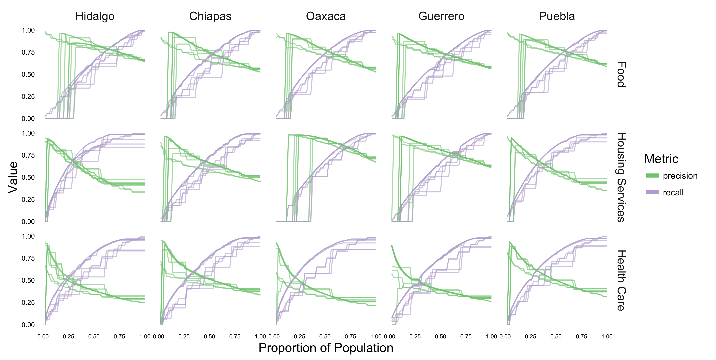
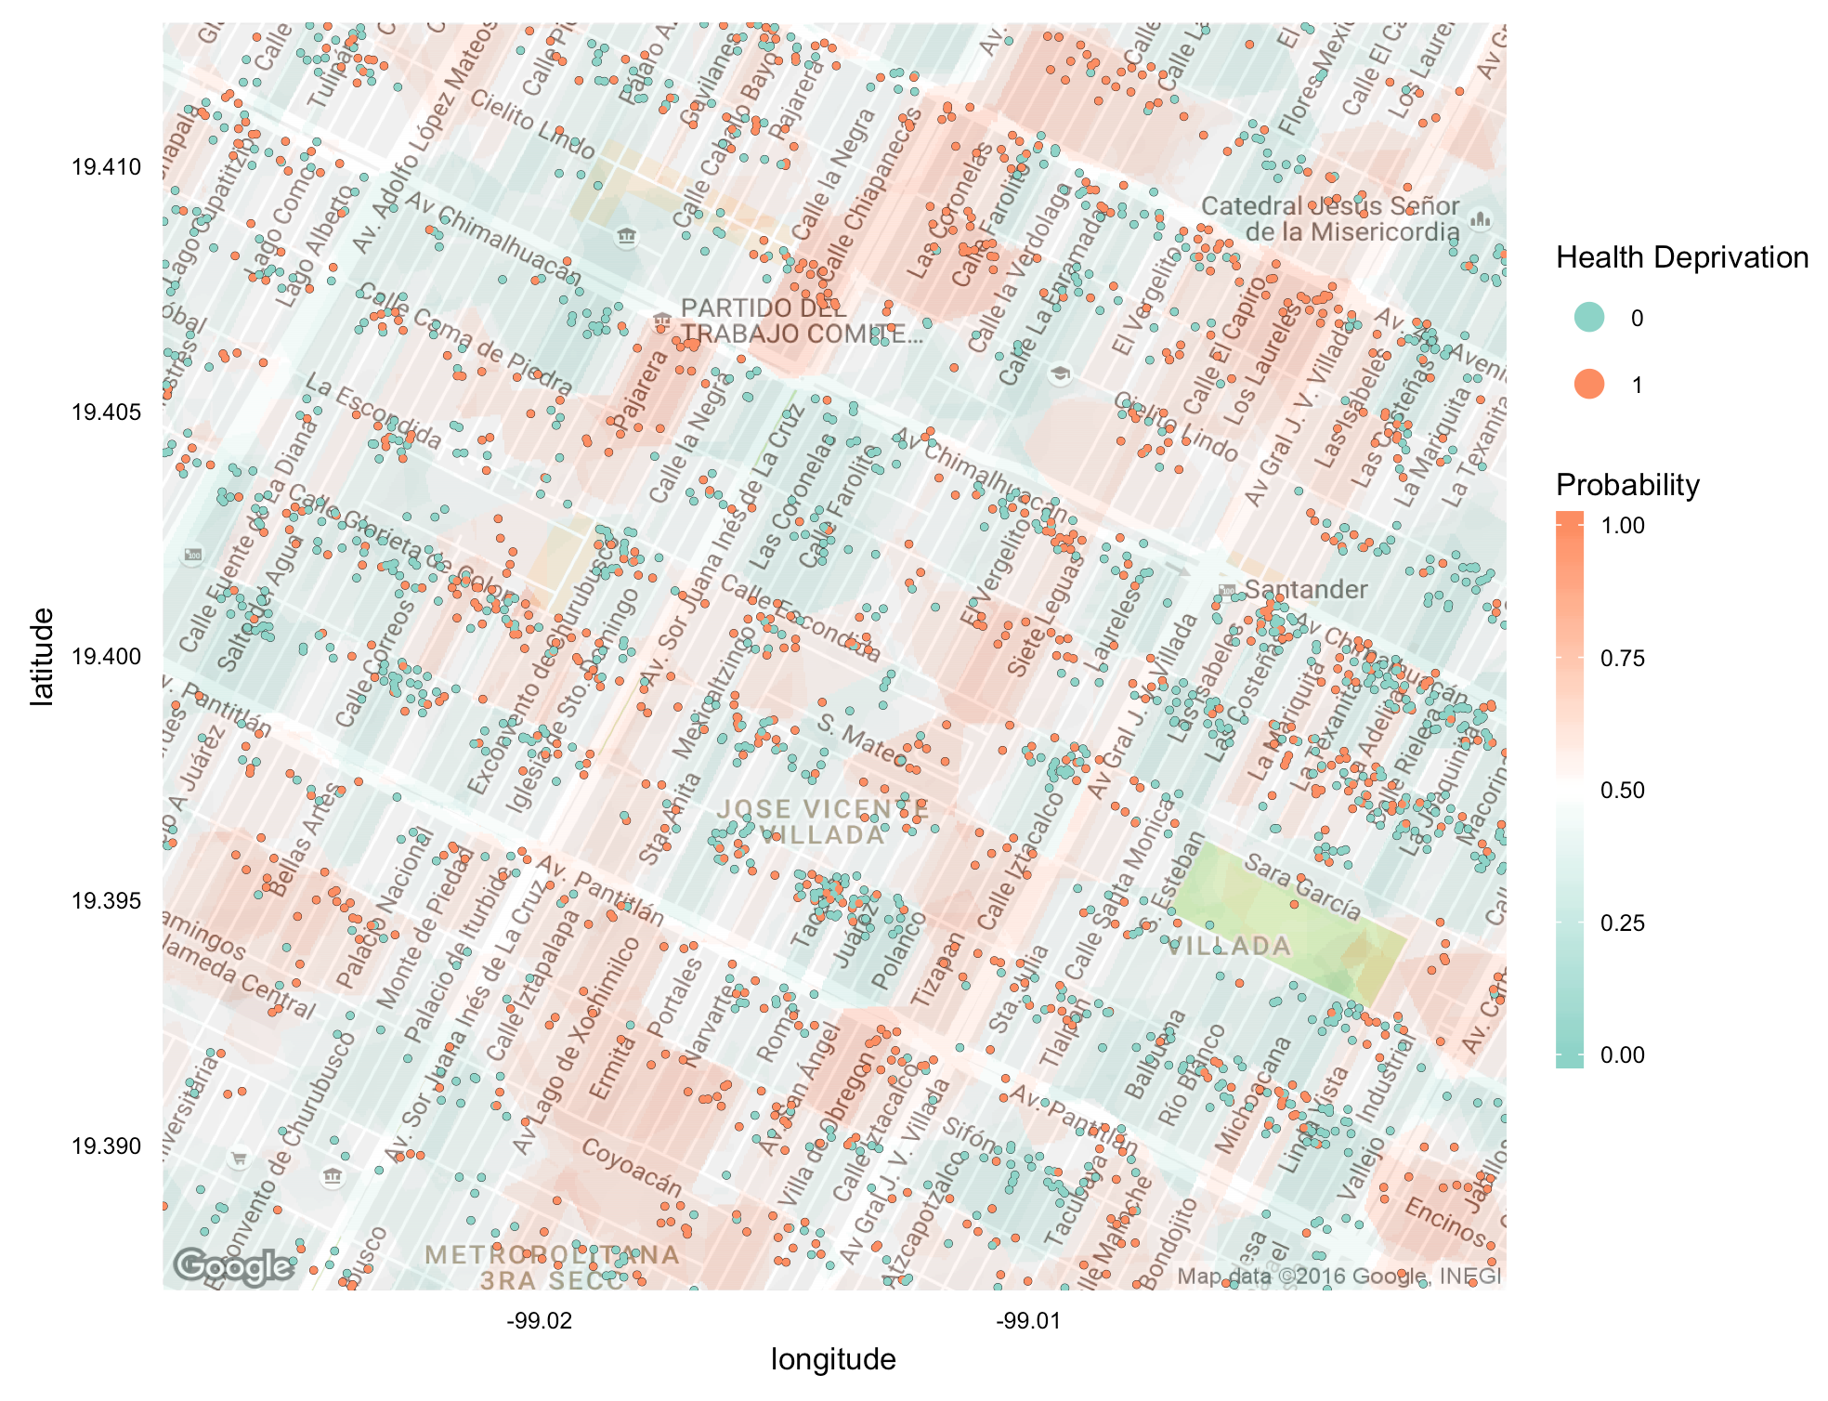
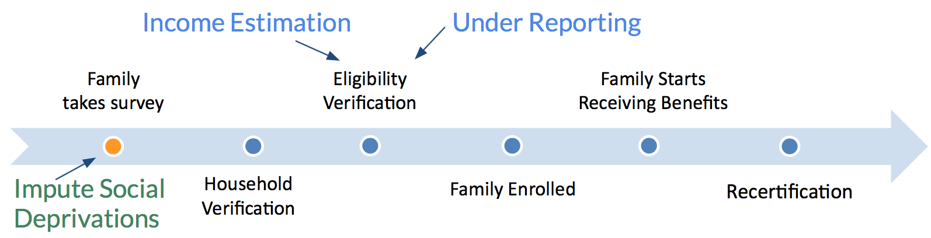
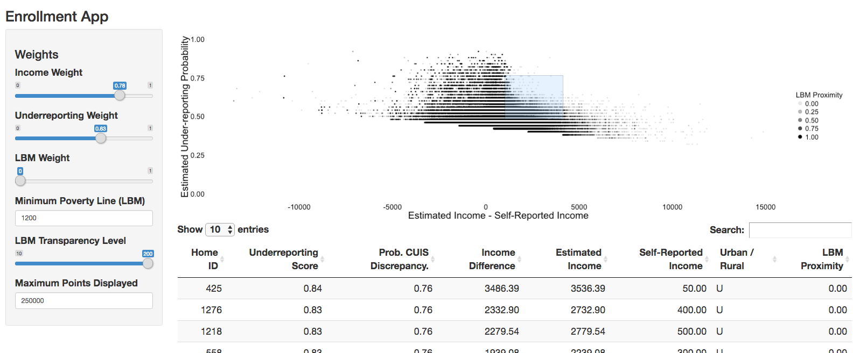
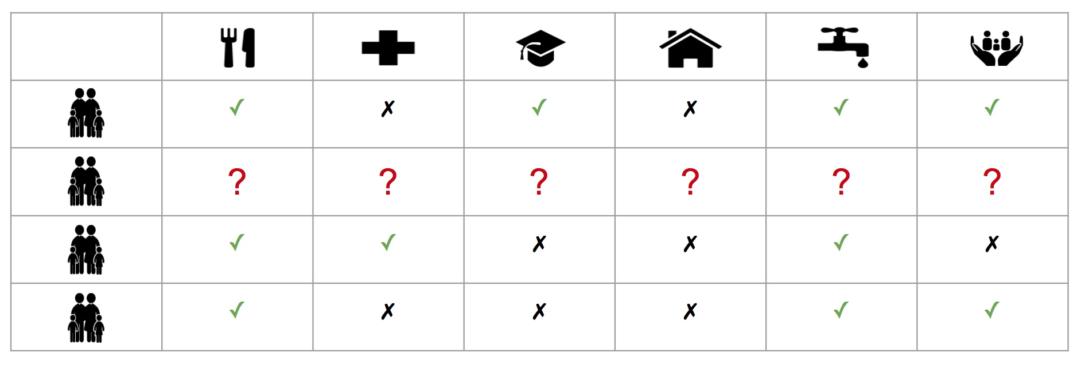

Enhancing the Distribution of Social Services in Mexico
Fernanda Alcalá-Durand
ITAM
Diego Garcia-Olano
U. Politècnica de Catalunya
Mobin Javed
UC Berkeley
Kris Sankaran
Stanford University
Adolfo De Unánue
ITAM
Paul van der Boor
University of Chicago
1
Socio-Economic Needs Prediction
Under-Reporting Detection
Introduction
3
Methods
4
Results
46% of Mexico’s population lives in poverty. To improve the situation of poverty, the Ministry of Social Development (SEDESOL) operates a range of social service programs that support families in need.
One of their major challenges is how to effectively identify and target the families in most need. This project aims to help SEDESOL identify:
1. People who might be under-reporting their socioeconomic conditions in order to qualify for programs, and
2. Which of the six socio-economic needs (food, health, education, quality of dwellings, basic housing services, social security) do the eligible families lack.
Socio-Economic Needs Prediction
We use the intersection of CUIS and PUB as labeled data to learn a mapping from spatial, census, and program enrollment characteristics to needs.
.
We used the Google geocoding API to get fine-grained spatial data at block-level and enrich our feature sets (Figure 3). To scale to the full data, we chose to parallelize across geographic subsets, estimating independent models for different regions.
Under-Reporting Detection
We designed a model to simulate the process of surveyor verification, using the verification module as labeled data. Rather than predict questions individually, we aggregate them to get a risk-of-underreporting measure and use this as the response variable (Figure 4).
We construct features from measurements available outside the verification module. In particular, we incorporate responses to the original survey and spatial coordinates.
Figure 5: Precision and recall for a collection of nearest neighbor and random forest classifiers using spatial features for prediction of food, health care, and housing services lacks. Performance of models varies across different geographic regions.
2
Problem Formulation
Figure 1 shows SEDESOL’s beneficiary enrollment process and points where our work intervenes:
To receive benefits for a given program, a family must first complete a home socioeconomic survey (CUIS) which is then verified by a social worker for discrepancies. The results are then processed to determine the family's monthly income estimate, their social needs, and eligibility. As there exist incentives to misrepresent one’s socioeconomic conditions during this process, some people may receive benefits improperly, taking resources away from those truly in need. Our first task is under-reporting detection to make sure those in most need are receiving benefits.
Of the 80 million individuals currently receiving benefits as recorded in the Registry of Beneficiaries database (PUB), only 20 million have completed home surveys in the CUIS database and as such are missing information about their social deprivation indicators. Our second task is then the prediction of socioeconomic needs for these families.
Figure 3: Example model fit using spatial coordinates. Points represent individuals, and are colored by the lack of healthcare. Background colors are fitted probabilities of the indicator, which can be used for prediction.
Figure 1: SEDESOL beneficiary enrollment process
Figure 6: Web interface for ranked list of under-reporting predictions. The rank is a function of CUIS discrepancy score, difference between self-reported and estimated income, and distance from poverty line.
5
Impact
Our work provides SEDESOL with data-driven predictions of the social needs their beneficiaries are lacking. These predictions can be used to facilitate targeting their social programs to the correct population.
The ranked list of possible under-reporting for current beneficiaries will contribute to improve their recertification process, potentially freeing resources from people who have come out of poverty to those in most need.
d( , )
Negative response
Positive response
Figure 4: The two bars represent self-reported and surveyor verified responses. We use the discrepancy between these as a response in the under-reporting model.
Figure 2: Families (rows) and their needs (columns)

